Slide 1
Lecture 1
ITEC618
Introduction to Computers, Programs, and Java
Programming Concepts

Slide 2
TODO Checklist – CANVAS walkthrough
Review CANVAS site (e.g. class times, deadlines, contacts, resources)
Review the unit outline (e.g. assessments, schedule, policies)
Locate all learning materials such as lecture slides, lab tasks, assessment guides
Get a textbook (eBook or hard copy)
Required textbook: Liang DY, 2018. Introduction to Java Programming and Data Structures, Comprehensive Version, Global Edition, 11th Edition, Pearson Education.
Online purchasing links:
https://www.pearson.com.au/9781292221892 (publisher e-text)
https://www.amazon.com.au/Introduction-Java-Programming-Structures-Global/dp/1292221879 (paperback)
Find your lab locations (on campus labs start from week 2)
Expected study time per week: 10-15 hours
Pre-view lecture slides, book chapters, lab tasks before each class
Workshop recordings after each class
Here is a checklist for you to follow for a smooth start to your course using the CANVAS learning management system. We emphasize the importance of familiarizing yourself with the CANVAS platform, reviewing the unit outline, accessing learning materials, and obtaining the required textbook. Additionally, we highlight the necessity of finding lab locations, allocating study time, and previewing lecture slides, book chapters, and lab tasks before classes. We also mention that workshop recordings will be available after each class.

Slide 3

Student Academic Integrity Module (AIM)
Explains the importance of acting with Academic Integrity
Provides information to assist you to act with Academic Integrity
Accessed through LMS: https://www.acu.edu.au/StudentAIM
Must get 100% on a short quiz; UNLIMITED attempts to pass
Must complete by start of Examinations
Final results withheld until completion
Queries? email: academic.integrity@acu.edu.au
We provide information about the Student Academic Integrity Module (AIM) at the ACU Peter Faber Business School. The AIM educates you on the importance of academic integrity and how to maintain it. You must complete this module, accessible through the provided LMS link, and achieve 100% on a short quiz (with unlimited attempts) before the start of examinations to have your final results released. For any queries, you can email the academic integrity team.

Slide 4
Acknowledgements
The slides used in this unit are adapted from the publisher’s slides of the textbook:
Daniel Liang 2018, Introduction to Java Programming and Data Structures, 11th edn, Pearson Education

Slide 5
Objectives
To understand computer basics, programs, and operating systems (§1.2–1.4).
To understand the meaning of Java language specification, API, JDK, and IDE (§1.6).
To write a simple Java program (§1.7).
To display the Java program output (§1.7).
To explain the basic syntax of a Java program (§1.7).
To create, compile, and run Java programs (§1.8).
To use sound Java programming style and document programs properly (§1.9).
To explain the differences between syntax errors, runtime errors, and logic errors (§1.10).

Slide 6
Open-Ended Question
How can understanding the basics of Java programming and software development improve your ability to create effective and efficient software solutions?
Understanding the basics of Java programming and software development is crucial for creating effective and efficient software solutions. Java, being a versatile and widely-used programming language, provides a strong foundation for developing various applications, from web-based to mobile and enterprise solutions. By learning Java, students gain skills in writing clean, efficient code, understanding object-oriented principles, and utilizing robust development environments like Eclipse.

Slide 7
Example
How can understanding the basics of Java programming and software development improve your ability to create effective and efficient software solutions?
For example, a developer in Sydney might use Java to build scalable backend systems for a growing tech company, such as Atlassian. Atlassian, an Australian enterprise software company, relies on Java for many of its backend services, ensuring that their software can handle increased user demands and maintain performance. This foundational knowledge not only opens up numerous career opportunities but also equips students with the problem-solving skills necessary to tackle complex software development challenges.

Slide 8
Example
How can understanding the basics of Java programming and software development improve your ability to create effective and efficient software solutions?
In essence, mastering Java programming and software development principles enables developers to create reliable, maintainable, and scalable software, which is essential in today's fast-paced and ever-evolving tech industry.

Slide 9
Open-Ended Question
Why is it important to understand the basic components of a computer and how they interact?
Understanding the basic components of a computer and how they interact is crucial because it helps you comprehend how software and hardware work together to perform tasks. This knowledge is foundational for troubleshooting, optimizing performance, and developing efficient programs that can leverage hardware capabilities effectively.

Slide 10
Example
In Sydney, companies like IBM often require their IT staff to have a thorough understanding of computer components to maintain and improve their data centers' performance. For instance, knowing how to optimize the use of CPUs and memory can significantly enhance the processing speed of large datasets, which is critical for data-driven projects.

Slide 11
What is a Computer?
A computer consists of a CPU, memory, hard disk, floppy disk, monitor, printer, and communication devices connected to the bus – transfer paths on the motherboard.
A computer is composed of several key components including the CPU, memory, storage devices, communication devices, input devices, and output devices. These components are interconnected by the bus, which serves as the transfer paths on the motherboard, allowing data to move between the different parts of the computer.

Slide 12
What is a Computer?
A computer consists of a CPU, memory, hard disk, floppy disk, monitor, printer, and communication devices connected to the bus – transfer paths on the motherboard.
Some CPU (Central Processing Unit) Parameters:
Clock Speed (GHz): Indicates how fast the CPU can execute instructions. Higher clock speeds generally mean better performance.
Core Count: More cores allow the CPU to handle more tasks simultaneously. This is important for multitasking and running complex applications.
Cache Size: Larger caches can store more data closer to the CPU, which speeds up data retrieval and processing.

Slide 13
What is a Computer?
A computer consists of a CPU, memory, hard disk, floppy disk, monitor, printer, and communication devices connected to the bus – transfer paths on the motherboard.
Some Motherboard Parameters:
Socket Type: The CPU socket type (e.g., LGA 1200, AM4) must match the CPU you plan to use.
RAM Compatibility: Check the supported RAM type (DDR4, DDR5), maximum capacity, and speed.

Slide 14
Imagine you want to build a gaming PC. You decide to purchase an Intel Core i7-12700K CPU. Here’s what you would look for:
CPU:
Clock Speed: 3.6 GHz base, up to 5.0 GHz boost.
Core Count: 12 cores (8 performance cores, 4 efficiency cores).
Threads: 20 threads.
Cache Size: 25 MB L3 cache.
TDP: 125W.
Integrated Graphics: Intel UHD Graphics 770.
Motherboard:
Socket Type: LGA 1700, compatible with the Intel Core i7-12700K.
Chipset: Z690 for overclocking support.
Form Factor: ATX for a full-sized build with ample expansion options.
RAM Compatibility: Supports DDR5 RAM, up to 128GB, with speeds up to 6400 MHz.
Expansion Slots: Multiple PCIe 5.0 slots for high-performance GPUs.
Storage Options: 6 SATA ports and 3 M.2 slots for SSDs.
Connectivity: USB 3.2 Gen 2x2 ports, Wi-Fi 6E, Bluetooth 5.2, and 2.5Gb Ethernet.
Power Phases: 16+1 power phases for stable overclocking.
BIOS/UEFI: User-friendly interface with advanced settings for fine-tuning performance.
By considering these parameters, you ensure you select components that work well together and meet your performance needs for gaming and other demanding tasks.

Slide 15
What is Computer Programs?
Computer programs, known as software, are instructions to the computer.
You tell a computer what to do through programs. Without programs, a computer is an empty machine. Computers do not understand human languages, so you need to use computer languages to communicate with them.
Programs are written using programming languages.

Slide 16
Programming Languages
Machine Language Assembly Language High-Level Language
Machine language is a set of primitive instructions built into every computer. The instructions are in the form of binary code, so you have to enter binary codes for various instructions. Program with native machine language is a tedious process. Moreover the programs are highly difficult to read and modify. For example, to add two numbers, you might write an instruction in binary like this:
1101101010011010

Slide 17
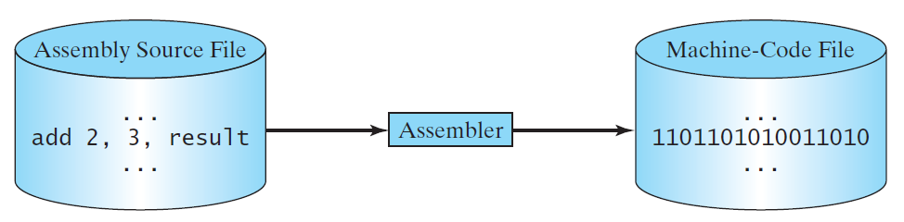
Programming Languages
Machine Language Assembly Language High-Level Language
Assembly languages were developed to make programming easy. Since the computer cannot understand assembly language, however, a program called assembler is used to convert assembly language programs into machine code. For example, to add two numbers, you might write an instruction in assembly code like this:
ADDF3 R1, R2, R3

Slide 18
Programming Languages
Machine Language Assembly Language High-Level Language
The high-level languages are English-like and easy to learn and program. For example, the following is a high-level language statement that computes the area of a circle with radius 5:
area = 5 * 5 * 3.1415;

Slide 19
Popular High-Level Languages
We provide an overview of several popular high-level programming languages, along with a brief description of each. These languages range from those designed for beginners (such as BASIC) to those used for specific applications like business (COBOL) or scientific computations (FORTRAN).

Slide 20
Popular High-Level Languages
Reasons to Choose Java in Australia:
Industry Demand: Java is widely used in various industries including finance, telecommunications, and retail. Many Australian companies, such as Commonwealth Bank, Telstra, and Atlassian, require Java skills for their software development projects.

Slide 21
Popular High-Level Languages
2. Versatility: Java's platform-independent nature makes it suitable for developing applications that run on various devices and operating systems. This versatility is beneficial for both startups and established businesses.

Slide 22
Popular High-Level Languages
3. Strong Community Support: Java has a large, active community in Australia, providing a wealth of resources such as tutorials, forums, and local meetups which can be very helpful for learners and professionals.

Slide 23
Popular High-Level Languages
4. Enterprise Usage: Large enterprises, including government agencies and financial institutions in Australia, often use Java for their backend systems due to its robustness and scalability.

Slide 24
Popular High-Level Languages
5. Job Opportunities: There is a high demand for Java developers in Australia, with numerous job openings in cities like Sydney, Melbourne, Brisbane, and Canberra. Companies like ANZ Bank, Optus, and Woolworths frequently seek Java developers, making it a promising career path for new graduates and experienced developers.

Slide 25
Popular High-Level Languages
6. APAC Focus: Australia's proximity to the Asia-Pacific region, where Java is also popular, provides additional opportunities for collaboration and employment across international markets.

Slide 26
Popular High-Level Languages
You will find job opportunities at several financial institutions, such as Westpac, that rely on Java for their backend systems. Additionally, you can join local Java user groups and attend meetups to network with other professionals, which helps you stay updated on the latest trends and job opportunities.

Slide 27
Interpreting/Compiling Source Code
A program written in a high-level language is called a source program or source code. Because a computer cannot understand a source program, a source program must be translated into machine code for execution. The translation can be done using another programming tool called an interpreter or a compiler.
When you write a program in a high-level language, it's called source code or a source program. Since computers can't understand this directly, the source code must be translated into machine code for execution. This translation is done using a tool called an interpreter or a compiler.

Slide 28
Interpreting/Compiling Source Code
A program written in a high-level language is called a source program or source code. Because a computer cannot understand a source program, a source program must be translated into machine code for execution. The translation can be done using another programming tool called an interpreter or a compiler.
You write a Java source code in a file named HelloWorld.java.
You then use the Java compiler (javac HelloWorld.java) to compile the source code into bytecode, producing a file named HelloWorld.class.
Finally, you run the bytecode using the Java interpreter (java HelloWorld), which executes the program and prints "Hello, World!" to the console.

Slide 29
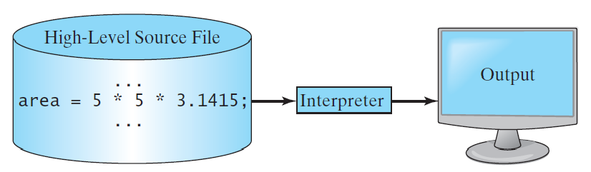
Interpreting Source Code
An interpreter reads one statement from the source code, translates it to the machine code or virtual machine code, and then executes it right away, as shown in the following figure. Note that a statement from the source code may be translated into several machine instructions.
When you use an interpreter to run a program, the interpreter reads one statement from the source code, translates it into machine code or virtual machine code, and then executes it immediately. This means that each line of code is processed and executed in sequence, which allows for interactive and incremental development.

Slide 30
Interpreting Source Code
An interpreter reads one statement from the source code, translates it to the machine code or virtual machine code, and then executes it right away, as shown in the following figure. Note that a statement from the source code may be translated into several machine instructions.
Imagine you are working at Atlassian in Sydney, developing a new feature for their software. You use Java to prototype and test your code. Although Java is compiled, the JVM interprets the bytecode, allowing you to debug and refine your feature efficiently.

Slide 31
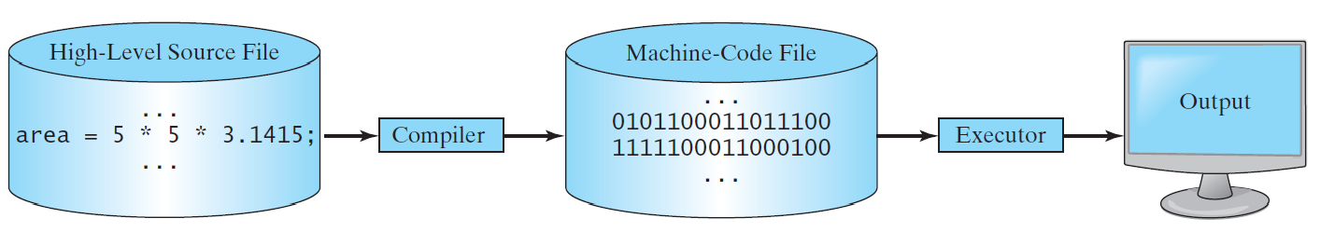
Compiling Source Code
A compiler translates the entire source code into a machine-code file, and the machine-code file is then executed, as shown in the following figure.
A compiler translates your entire source code into a machine-code file, which is then executed by the computer. This process involves converting the high-level code into a low-level code that the computer's processor can understand and execute directly.

Slide 32
Compiling Source Code
A compiler translates the entire source code into a machine-code file, and the machine-code file is then executed, as shown in the following figure.
Difference Between Compiling Source Code and Interpreting Source Code:
Compiling Source Code: A compiler translates the entire source code into a machine-code file before execution. This machine-code file is then executed by the computer. This approach typically results in faster execution since the translation is done upfront. However, debugging can be more complex because you need to recompile the code after making changes.

Slide 33
Compiling Source Code
A compiler translates the entire source code into a machine-code file, and the machine-code file is then executed, as shown in the following figure.
Interpreting Source Code: An interpreter translates the source code into machine code or virtual machine code line by line and executes it immediately. This allows for easier debugging and interactive development since you can run and test each line of code without needing to recompile. However, interpreted code generally runs slower than compiled code because translation happens during execution.

Slide 34
Compiling Source Code
A compiler translates the entire source code into a machine-code file, and the machine-code file is then executed, as shown in the following figure.
Imagine you are a developer at Atlassian in Sydney. You have written a new feature in Java and you want to ensure it runs efficiently in production. You use a compiler to translate your Java source code into bytecode, which is then executed by the Java Virtual Machine (JVM). This compiled approach ensures your code runs faster compared to interpreting each line during execution.

Slide 35
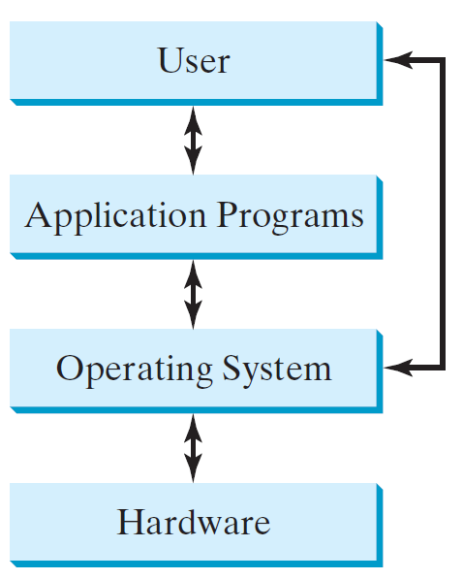
Operating Systems
The operating system (OS) is a program that manages and controls a computer’s activities. The popular operating systems for general-purpose computers are Microsoft Windows, Mac OS, and Linux. Application programs, such as a Web browser or a word processor, cannot run unless an operating system is installed and running on the computer.
An operating system (OS) is a program that manages and controls a computer's activities. Popular operating systems for general-purpose computers include Microsoft Windows, Mac OS, and Linux. Application programs, such as web browsers or word processors, require an operating system to be installed and running on the computer to function.

Slide 36
Operating Systems
The operating system (OS) is a program that manages and controls a computer’s activities. The popular operating systems for general-purpose computers are Microsoft Windows, Mac OS, and Linux. Application programs, such as a Web browser or a word processor, cannot run unless an operating system is installed and running on the computer.
Microsoft Windows: Known for its user-friendly interface and compatibility with a wide range of software and hardware. It is the most popular OS for personal computers and widely used in businesses.

Slide 37
Operating Systems
The operating system (OS) is a program that manages and controls a computer’s activities. The popular operating systems for general-purpose computers are Microsoft Windows, Mac OS, and Linux. Application programs, such as a Web browser or a word processor, cannot run unless an operating system is installed and running on the computer.
Mac OS: Developed by Apple, Mac OS is known for its sleek design, robust security, and seamless integration with other Apple products. It is popular among creative professionals such as designers and video editors.

Slide 38
Operating Systems
The operating system (OS) is a program that manages and controls a computer’s activities. The popular operating systems for general-purpose computers are Microsoft Windows, Mac OS, and Linux. Application programs, such as a Web browser or a word processor, cannot run unless an operating system is installed and running on the computer.
Linux: An open-source operating system that is highly customizable and known for its stability and security. It is widely used in servers, supercomputers, and by developers who need a flexible environment

Slide 39
Operating Systems
Imagine you are a software developer at Atlassian in Sydney. You use different operating systems for various tasks:
Microsoft Windows on your work laptop for compatibility with enterprise software and productivity tools.
Mac OS on your personal laptop for graphic design and video editing projects.
Linux on your development server for running and testing software applications due to its stability and security.

Slide 40
Open-Ended Question
How does understanding the Java language specification and the tools available (API, JDK, IDE) improve your coding efficiency?
Understanding the Java language specification and the tools available, such as the API, JDK, and IDE, improves coding efficiency by providing you with the knowledge and resources to write, compile, and debug code more effectively. These tools offer a structured environment that simplifies development tasks, enhances code quality, and accelerates the development process.

Slide 41
Example
In Melbourne, software developers at companies like ANZ Bank use Java IDEs like Eclipse to develop and maintain their banking applications. These tools help ensure that the applications are robust, secure, and efficient, which is crucial in the financial industry.

Slide 42
Why Java?
The answer is that Java enables users to develop and deploy applications on the Internet for servers, desktop computers, and small hand-held devices. The future of computing is being profoundly influenced by the Internet, and Java promises to remain a big part of that future. Java is the Internet programming language.
Java is a general-purpose programming language.
Java is the Internet programming language.

Slide 43
Java, Web, and Beyond
Java can be used to develop standalone applications.
Java can be used to develop applications running from a browser.
Java can also be used to develop applications for hand-held devices.
Java can be used to develop applications for Web servers.

Slide 44
Java’s History
James Gosling and Sun Microsystems
Oak – basis of Java, but a different language
Java, May 20, 1995, Sun World
Sun acquisition by Oracle, 2009
HotJava
The first Java-enabled Web browser
Early History Website:
http://www.java.com/en/javahistory/index.jsp

Slide 45
Java DK Versions
JDK 1.02 (1995)
JDK 1.1 (1996)
JDK 1.2 (1998)
JDK 1.3 (2000)
JDK 1.4 (2002)
JDK 1.5 (2004) a. k. a. JDK 5 or Java 5
JDK 1.6 (2006) a. k. a. JDK 6 or Java 6
JDK 1.7 (2011) a. k. a. JDK 7 or Java 7
JDK 1.8 (2014) a. k. a. JDK 8 or Java 8
…
The latest JDK 17 (2021) https://www.oracle.com/java/technologies/downloads/
JDK (Java Development Kit) contains Java Complier, JRE (Java Runtime Environment), and other tools.

Slide 46
JDK Editions
Java Standard Edition (Java SE)
used to develop client-side standalone applications or applets.
Java Enterprise Edition (Java EE)
used to develop server-side applications such as Java servlets, Java ServerPages, and Java ServerFaces.
Java Micro Edition (Java ME).
used to develop applications for mobile devices such as cell phones.
This book uses Java SE to introduce Java programming.
We explain the different editions of the Java Development Kit (JDK). Java Standard Edition (Java SE) is used for developing client-side standalone applications or applets. Java Enterprise Edition (Java EE) is used for developing server-side applications like servlets, JavaServer Pages (JSP), and JavaServer Faces (JSF). Java Micro Edition (Java ME) is used for developing applications for mobile devices such as cell phones. This book uses Java SE to introduce Java programming.

Slide 47
Open-Ended Question
What are the essential elements of a basic Java program, and why is each element important?
The essential elements of a basic Java program include the class declaration, the main method, statements, and syntax elements like semicolons and braces. Each element is important because they define the structure and flow of the program, ensuring that the code executes correctly and is easy to read and maintain.

Slide 48
Example
In Brisbane, tech startups often require new developers to write simple Java programs to demonstrate their understanding of basic syntax and structure. For instance, a startup might ask a developer to create a Java application that processes customer data, showcasing their ability to write clean and functional code.

Slide 49
A First Java Program
Listing 1.1
// This program prints Welcome to Java!
public class Welcome {
public static void main(String[] args) {
System.out.println("Welcome to Java!");
}
}
Note: Clicking the green button displays the source code with interactive animation. You can also run the code in a browser. Internet connection is needed for this button.
Welcome
We present a simple Java program (Listing 1.1) that prints "Welcome to Java!" to the console. We demonstrate the basic structure of a Java program, including the class definition and the main method, which is the entry point of any Java application.

Slide 50
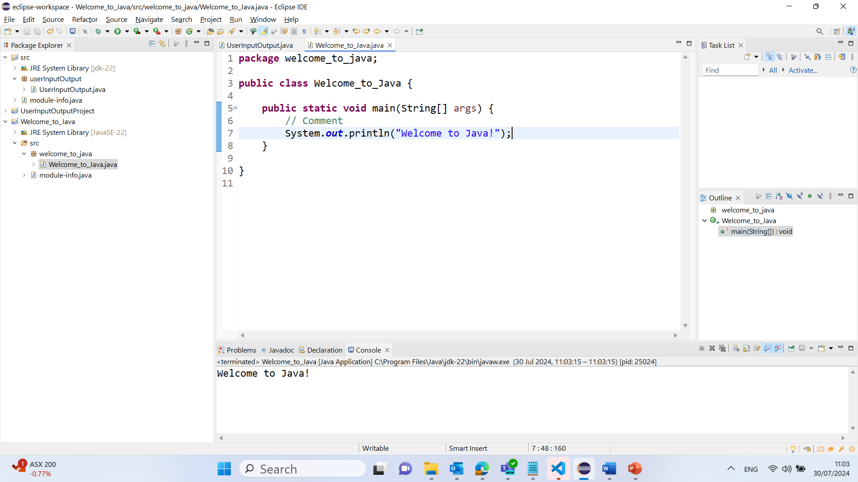
package welcome_to_java;
public class Welcome_to_Java {
public static void main(String[] args) {
// Comment
System.out.println("Welcome to Java!");
}
}
public class Welcome: Defines a public class named Welcome.
public static void main(String[] args): The main method is the entry point of the program.
System.out.println("Welcome to Java!");: Prints the message "Welcome to Java!" to the console.
This simple program introduces you to the fundamental components of a Java program, such as classes, methods, and the standard output function. By running this program, you get a practical understanding of how Java code is structured and executed.

Slide 51
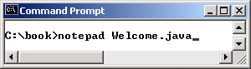
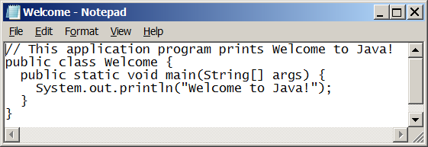
Creating and Editing Using NotePad
To use NotePad, type
notepad Welcome.java
from the DOS prompt.

Slide 52
Open-Ended Question
How does the Java Development Kit (JDK) and Java Runtime Environment (JRE) facilitate the development and execution of Java programs?
The JDK and JRE facilitate the development and execution of Java programs by providing the necessary tools to compile, debug, and run Java applications. The JDK includes the compiler and other development tools, while the JRE provides the libraries and JVM required to run Java programs.

Slide 53
Example
In Canberra, government agencies developing internal applications use the JDK and JRE to ensure their software is secure, reliable, and compatible with various systems. For example, a Java application developed for managing public records must run smoothly across different platforms, which is facilitated by the JRE.

Slide 54
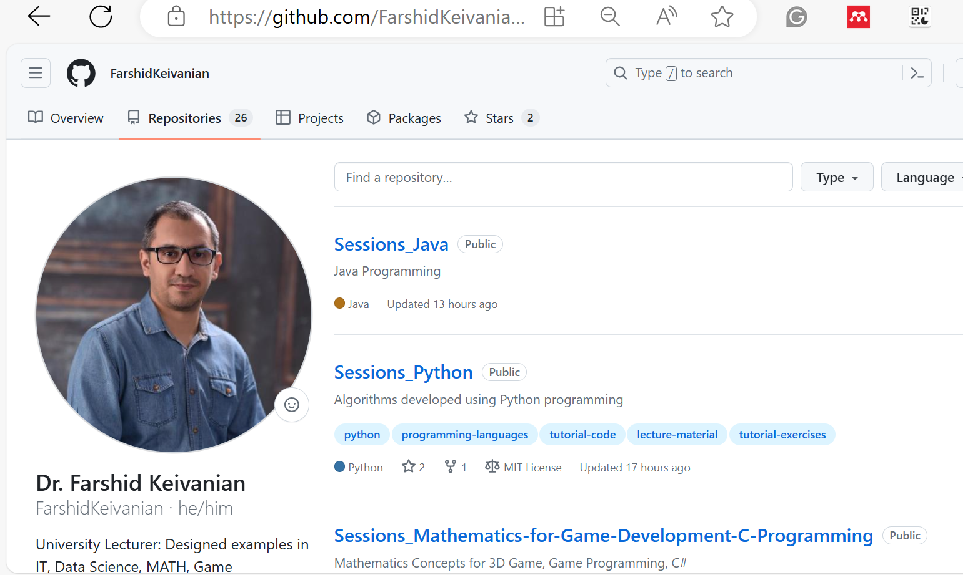
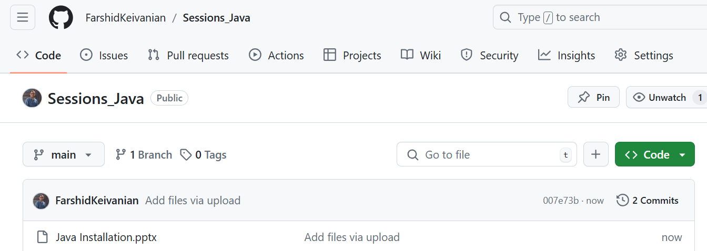

Java Installation

Slide 55
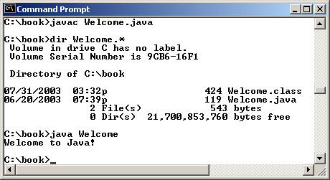
Compiling and Running Java from the Command Window
Download and install the latest JDK
Set path to JDK bin directory
set path=c:\Program Files\java\jdk1.8.0\bin
Compile
javac Welcome.java
Run
java Welcome
Note: external tutorial videos are available on LEO

Slide 56
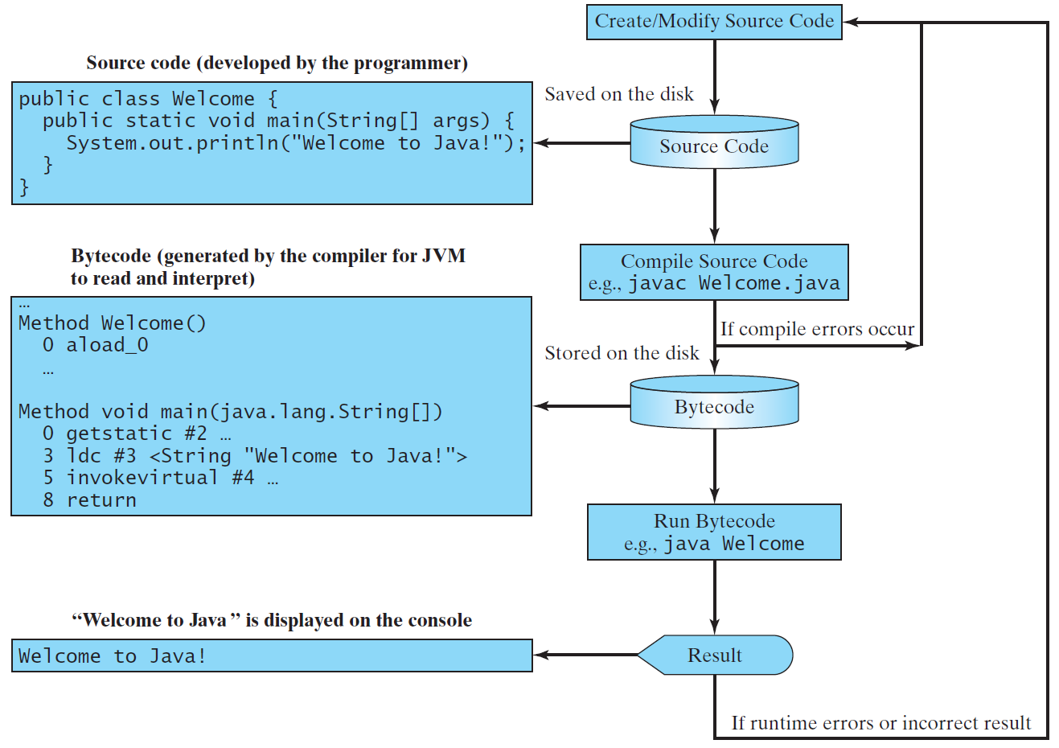
Creating, Compiling, and Running Programs
Bytecode?
JVM in JRE

Slide 57

Trace a Program Execution
Enter main method
// This program prints Welcome to Java!
public class Welcome {
public static void main(String[] args) {
System.out.println("Welcome to Java!");
}
}
In Java, public static void main(String[] args) is the method signature that defines the main method, which is the entry point for any Java application. Here's a breakdown of each part:
public: The method is accessible from anywhere.
static: The method belongs to the class, not an instance of the class. This means you can call this method without creating an object of the class.
void: The method does not return any value.
main: This is the name of the method that the Java Virtual Machine (JVM) looks for as the starting point of a Java program.
String[] args: This is an array of String objects that allows the JVM to pass command-line arguments to the program.

Slide 58

Trace a Program Execution
Execute statement
// This program prints Welcome to Java!
public class Welcome {
public static void main(String[] args) {
System.out.println("Welcome to Java!");
}
}
The line System.out.println("Welcome to Java!"); in a Java program is used to print the specified message to the console. Here's a detailed breakdown:
System: This is a built-in class in the java.lang package that provides access to system-related resources and utilities.
out: This is a static field in the System class that represents the standard output stream, typically the console.
println: This is a method of the PrintStream class, which is the type of the out field. The println method prints the provided message followed by a newline character.
When this line of code is executed, it sends the text "Welcome to Java!" to the console and then moves the cursor to the next line.

Slide 59
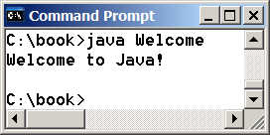
Trace a Program Execution
// This program prints Welcome to Java!
public class Welcome {
public static void main(String[] args) {
System.out.println("Welcome to Java!");
}
}
print a message to the console

Slide 60
Two More Simple Examples
WelcomeWithThreeMessages
ComputeExpression

Slide 61
Popular Java IDEs
Eclipse (preferred in this unit)
IntelliJ
NetBeans
IDE = Integrated Development Environment
Also remember to correctly download and install JDK before you can use IDEs!

Slide 62
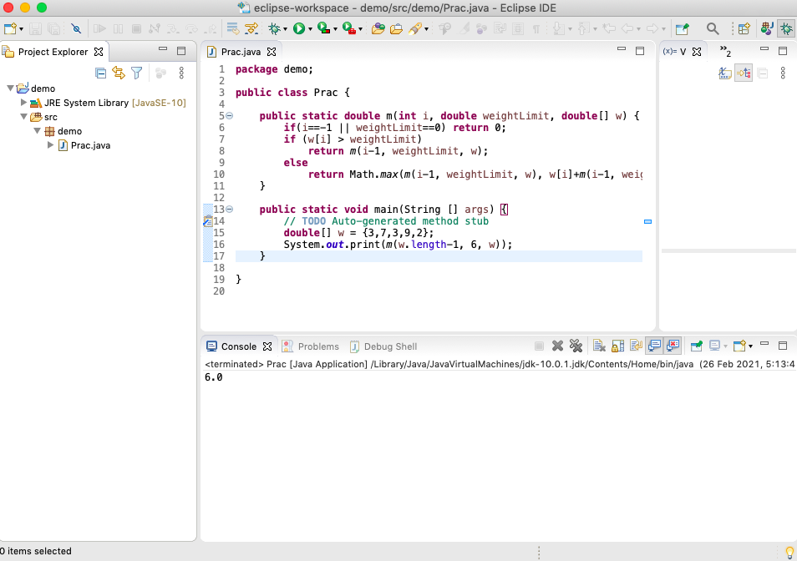
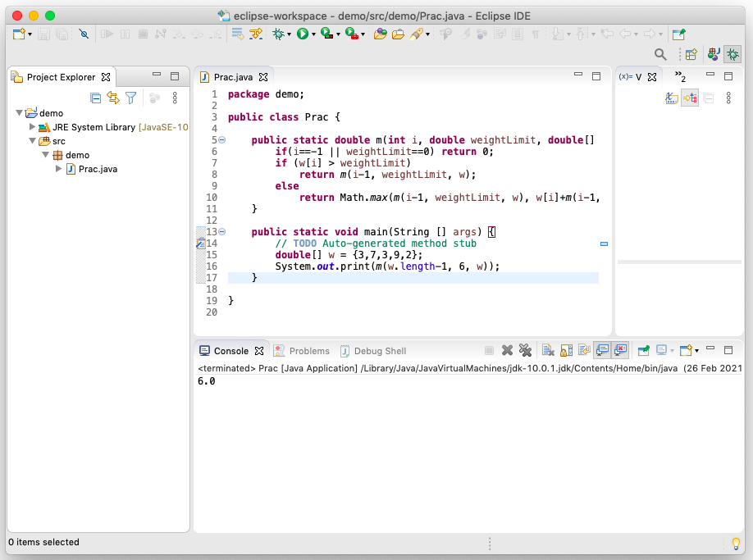
Compiling and Running Java from Eclipse
Note: external Eclipse tutorial video are available on LEO

Slide 63
Anatomy of a Java Program
Class name
Main method
Statements
Statement terminator
Reserved words
Comments
Blocks

Slide 64

Class Name
Every Java program must have at least one class. Each class has a name. By convention, class names start with an uppercase letter. In this example, the class name is Welcome.
// This program prints Welcome to Java!
public class Welcome {
public static void main(String[] args) {
System.out.println("Welcome to Java!");
}
}
Every Java program must have at least one class, and each class has a name. By convention, class names start with an uppercase letter. In the given example, the class name is Welcome.

Slide 65
Main Method
Line 2 defines the main method. In order to run a class, the class must contain a method named main. The program is executed from the main method.
// This program prints Welcome to Java!
public class Welcome {
public static void main(String[] args) {
System.out.println("Welcome to Java!");
}
}

Slide 66
Statement
A statement represents an action or a sequence of actions. The statement System.out.println("Welcome to Java!") in the program in Listing 1.1 is a statement to display the greeting "Welcome to Java!“.
// This program prints Welcome to Java!
public class Welcome {
public static void main(String[] args) {
System.out.println("Welcome to Java!");
}
}

Slide 67

Statement Terminator
Every statement in Java ends with a semicolon (;).
// This program prints Welcome to Java!
public class Welcome {
public static void main(String[] args) {
System.out.println("Welcome to Java!");
}
}

Slide 68
Reserved words
Reserved words or keywords in Java are predefined words that have special meanings to the compiler and cannot be used for variable names, ensuring proper code syntax and functionality.
Reserved words or keywords are words that have a specific meaning to the compiler and cannot be used for other purposes in the program. For example, when the compiler sees the word class, it understands that the word after class is the name for the class.
// This program prints Welcome to Java!
public class Welcome {
public static void main(String[] args) {
System.out.println("Welcome to Java!");
}
}

Slide 69

Blocks
A pair of braces in a program forms a block that groups components of a program.
In Java, a pair of braces {} forms a block that groups components of a program. The example illustrates two types of blocks: a class block that contains the entire class definition and a method block that contains the statements within a method.

Slide 70

Special Symbols
his slide lists special symbols used in Java programming along with their meanings:
{}: Opening and closing braces denote a block to enclose statements.
(): Opening and closing parentheses are used with methods.
[]: Opening and closing brackets denote an array.
//: Double slashes precede a comment line.
"": Opening and closing quotation marks enclose a string (sequence of characters).
;: Semicolon marks the end of a statement

Slide 71
{ … }
// This program prints Welcome to Java!
public class Welcome {
public static void main(String[] args) {
System.out.println("Welcome to Java!");
}
}

Slide 72
( … )
// This program prints Welcome to Java!
public class Welcome {
public static void main(String[] args) {
System.out.println("Welcome to Java!");
}
}

Slide 73
;
// This program prints Welcome to Java!
public class Welcome {
public static void main(String[] args) {
System.out.println("Welcome to Java!");
}
}

Slide 74
// …
// This program prints Welcome to Java!
public class Welcome {
public static void main(String[] args) {
System.out.println("Welcome to Java!");
}
}

Slide 75
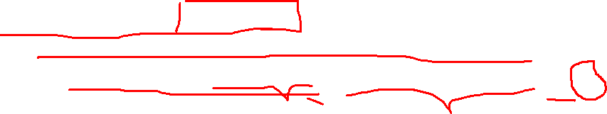
" … "
// This program prints Welcome to Java!
public class Welcome {
public static void main(String[] args) {
System.out.println("Welcome to Java!");
}
}

Slide 76
Programming Style and Documentation
Appropriate Comments
Naming Conventions
Proper Indentation and Spacing Lines
Block Styles
Your code will be assessed based on these!

Slide 77
Appropriate Comments
Include a summary at the beginning of the program to explain what the program does, its key features, its supporting data structures, and any unique techniques it uses.
Include your name, class section, instructor, date, and a brief description at the beginning of the program.

Slide 78

Naming Conventions
Choose meaningful and descriptive names.
Class names:
Capitalize the first letter of each word in the name. For example, the class name ComputeExpression.
To improve code readability and maintainability, we should choose meaningful and descriptive names for our classes. Class names should capitalize the first letter of each word in the name, following the CamelCase convention. For example, the class name ComputeExpression is clear and follows the proper naming convention.

Slide 79
Proper Indentation and Spacing
Indentation
Indent by a tab space.
Spacing
Use blank line to separate segments of the code.
Proper indentation and spacing are crucial for making your code readable and maintainable. Indent your code by a tab space and use blank lines to separate different segments of the code, enhancing clarity and organization.

Slide 80
Block Styles
Use end-of-line style for braces.

Slide 81

Programming Errors
Syntax Errors
Detected by the compiler
Runtime Errors
Causes the program to abort
Logic Errors
Produces incorrect result
Understanding programming errors is crucial for debugging and improving your code. There are three main types of errors:
Syntax Errors: These are detected by the compiler when the code does not follow the correct syntax rules of the language.
Runtime Errors: These occur during program execution and cause the program to terminate unexpectedly.
Logic Errors: These result in incorrect output because the logic of the program is flawed

Slide 82
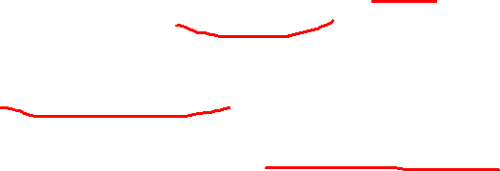
package banking_app;
public class BankingApp {
public static void main(String[] args) {
// Syntax Error Example: Missing semicolon
// double balance = 1000.00
// Runtime Error Example: Division by zero
// int result = 10 / 0;
// Logic Error Example: Incorrect calculation
double balance = 1000.00;
double deposit = 200.00;
double withdrawal = 150.00;
// Incorrect logic for updating balance
// Should be: balance = balance + deposit - withdrawal;
balance = balance + deposit + withdrawal;
System.out.println("Final balance: $" + balance);
}
}
The logic error occurs in the calculation for updating the balance. This code incorrectly adds both the deposit and the withdrawal amounts to the balance, which is not the intended financial operation. The correct calculation should add the deposit to the balance and subtract the withdrawal.

Slide 83
Syntax Errors
public class ShowSyntaxErrors {
public static main(String[] args) {
System.out.println("Welcome to Java);
}
}
ShowSyntaxErrors

Slide 84
Runtime Errors
public class ShowRuntimeErrors {
public static void main(String[] args) {
System.out.println(1 / 0);
}
}
ShowRuntimeErrors

Slide 85
Logic Errors
public class ShowLogicErrors {
public static void main(String[] args) {
System.out.println("Celsius 35 is Fahrenheit degree ");
System.out.println((9 / 5) * 35 + 32);
}
}
ShowLogicErrors

Slide 86
Assessment 1 (30%) Labs
Programming Practical that contains
Biweekly due lab sessions (week 2, 4, 6, 8 and 10, 30%)
Details in the ‘Assessment 1 Guide’ document under the ‘Assessment’ section on LEO.
Lab 1 starting and due in the lab next week
Get Java and IDE correctly installed.
Write your first Java programs.
Lab protocols:
Bring your own device
Engagement (50%) and Task Completion (50%)
Attend the lab on time and throughout the session until you are marked off, show you are engaged in solving the lab tasks by communicating with lab tutor and other students in the class
Show tutor how your code can be run with the desirable output on your laptop
Clearly explain to the tutor the logic and structure of your code and answer tutor’s questions if there are any.
Submit your documented code on LEO by the end of the lab day
Assessment 1 is a programming practical that includes biweekly lab sessions (week 2, 4, 6, 8, and 10) contributing to 30% of your overall grade. Details can be found in the 'Assessment 1 Guide' document under the 'Assessment' section on LEO (Learning Environment Online).

Slide 87
Assessment 1 (30%) Labs
Lab 1:
Start and Due Date: Lab 1 begins and is due in the lab session next week.
Tasks:
Ensure Java and your Integrated Development Environment (IDE) are correctly installed.
Write your first Java programs.
Lab Protocols:
Bring Your Own Device: Make sure you have your laptop with the required software installed.
Engagement and Task Completion:
Engagement counts for 50% of your lab grade. This means you need to actively participate in lab activities, communicate with the lab tutor and other students, and stay engaged throughout the session.
Task Completion also counts for 50%. Complete the lab tasks as instructed and show that your code works as expected.

Slide 88

Step-by-Step Guide:
Prepare Your Device:
Install Java Development Kit (JDK).
Install an IDE (such as IntelliJ IDEA, Eclipse, or NetBeans).
Write Your First Java Programs:
Create a simple Java program, like printing "Hello, World!".
Ensure your code runs without errors.
Attend the Lab:
Arrive on time and bring your laptop.
Stay for the entire session until you are marked off by the tutor.
Actively participate in lab tasks, ask questions, and engage with the tutor and classmates.
Show Your Work:
Demonstrate to the tutor that your code runs correctly and produces the desired output on your laptop.
Clearly explain the logic and structure of your code to the tutor.
Be prepared to answer any questions the tutor may have about your code.
Submit Your Work:
Document your code properly with comments explaining the purpose of each section.
Submit your documented code on LEO by the end of the lab day.

Slide 89
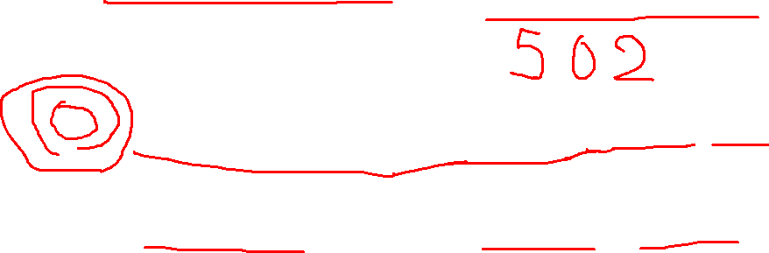
Make-Up Session for Lab Week 2
9th of August - Friday 3-5 PM
6th of August – Tuesday 3-5 PM

Slide 90
Interactive Multiple-Choice Questions
What is the primary function of a computer's CPU?
A. To store data
B. To process instructions
C. To display output
D. To manage network connections

Slide 91
Interactive Multiple-Choice Questions
Which of the following is NOT part of the Java Development Kit (JDK)?
A. Compiler
B. JVM
C. Debugger
D. IDE

Slide 92
Interactive Multiple-Choice Questions
What is the purpose of the main method in a Java program?
A. To declare variables
B. To execute the program
C. To define classes
D. To import libraries

Slide 93
Interactive Multiple-Choice Questions
What does the Java Runtime Environment (JRE) provide?
A. Development tools
B. Compiler
C. Libraries and JVM
D. Debugger

Slide 94
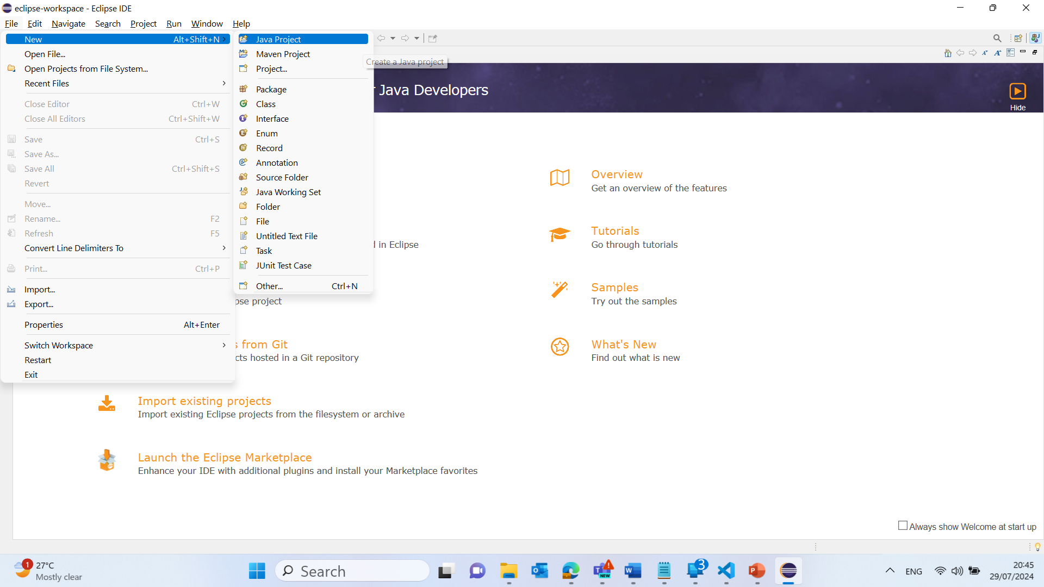
Simple User Input and Output Analysis in Java
1. Click on "Create a new Java project":
This will open a new window where you can set up your project.

Slide 95
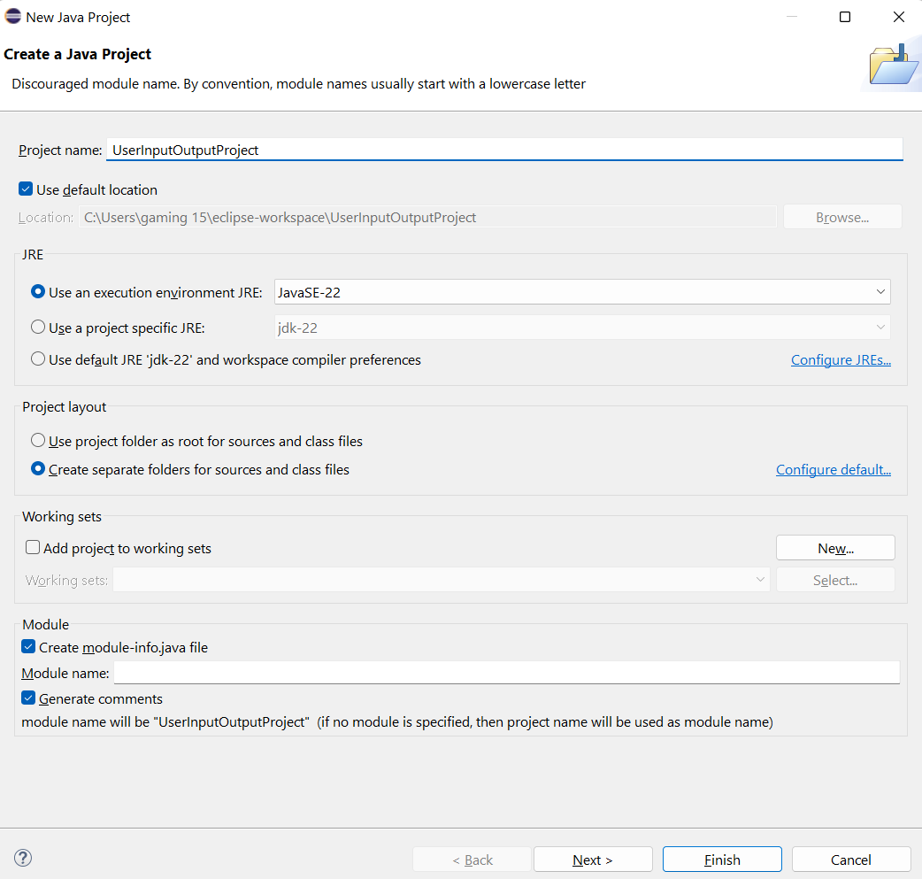
Simple User Input and Output Analysis in Java
2. Set up the new project:
Enter a project name (e.g., UserInputOutputProject).
Click Finish.

Slide 96
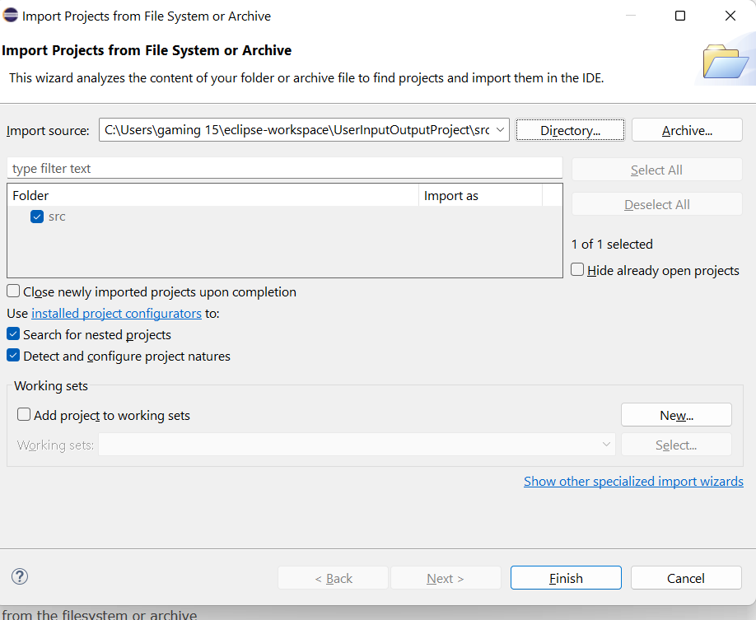
Simple User Input and Output Analysis in Java
2. Set up the new project:
Enter a project name (e.g., UserInputOutputProject).
Click Finish.

Slide 97
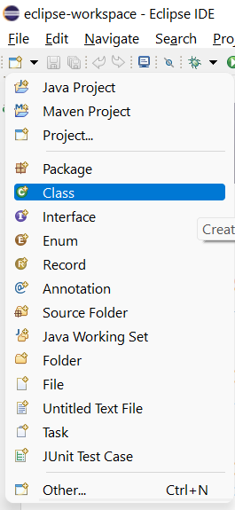
Simple User Input and Output Analysis in Java
3. Create a new Java class:
File >> Open Projects from File Systems >> Directory >> Choose the Direct where the Project is Saved ‘e.g. C:\Users\gaming 15\eclipse-workspace\UserInputOutputProject\src’
Click on Select Folder
Select New > Class.

Slide 98
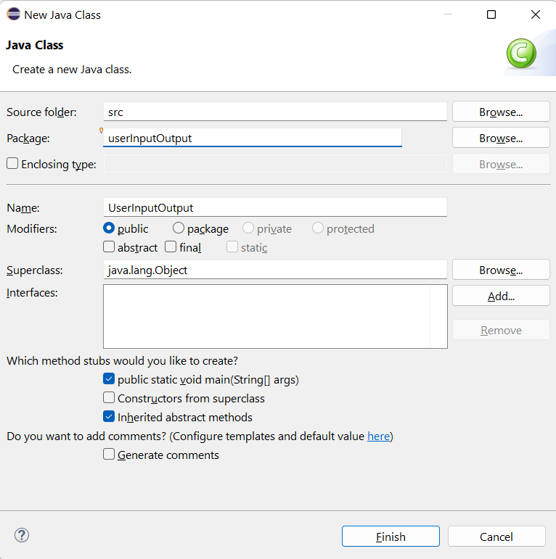
Simple User Input and Output Analysis in Java
Enter a class name (e.g., UserInputOutput).
Ensure the public static void main(String[] args) option is checked.
Click Finish.
Click on Hide (Front Page)

Slide 99
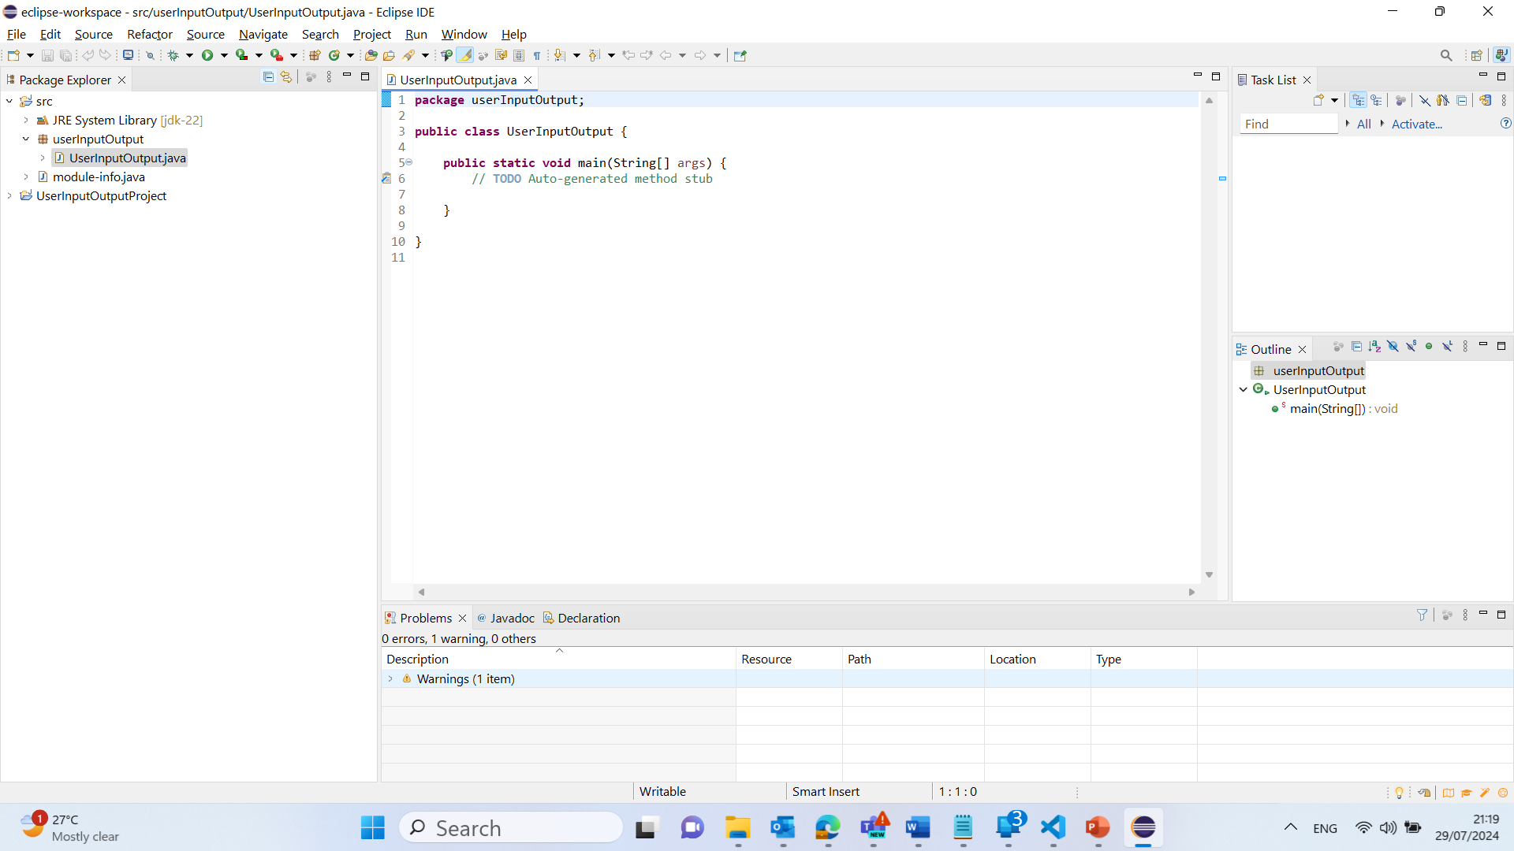
Simple User Input and Output Analysis in Java
4. Write your Java code:
Copy and paste the code into the newly created class:

Slide 100
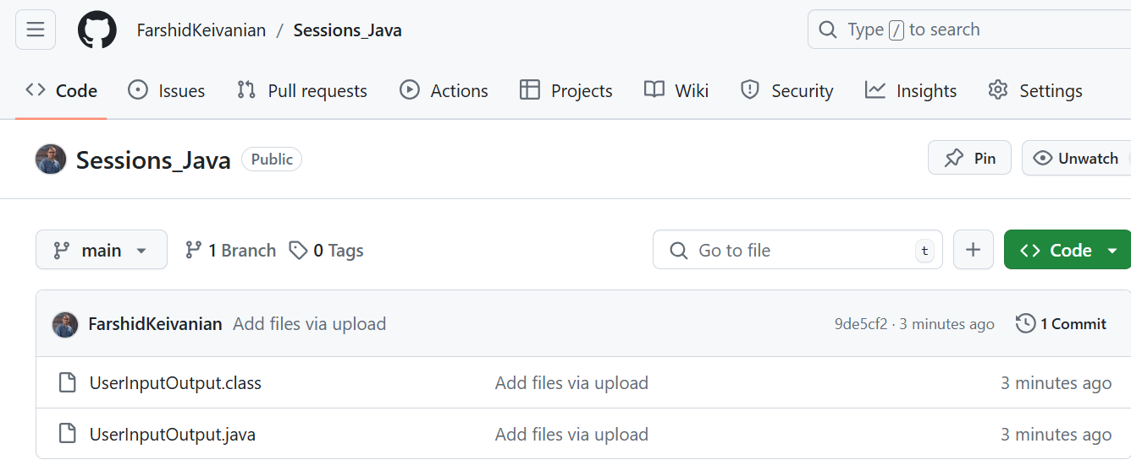
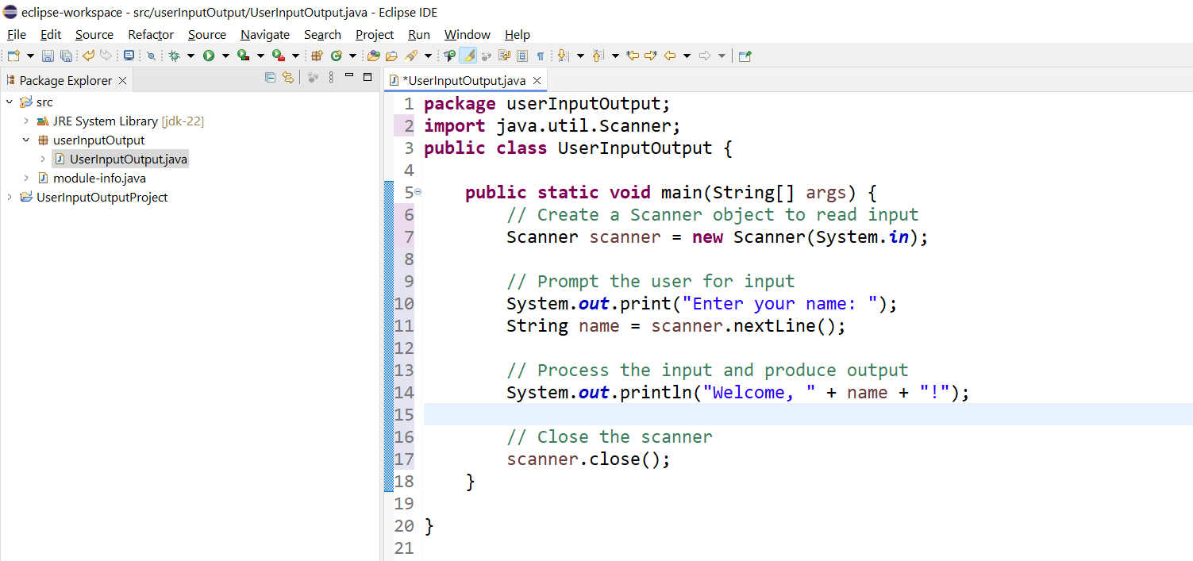
package userInputOutput;
import java.util.Scanner;
public class UserInputOutput {
public static void main(String[] args) {
// Create a Scanner object to read input
Scanner scanner = new Scanner(System.in);
// Prompt the user for input
System.out.print("Enter your name: ");
String name = scanner.nextLine();
// Process the input and produce output
System.out.println("Welcome, " + name + "!");
// Close the scanner
scanner.close();
}
}

Slide 101
package userInputOutput;
import java.util.Scanner;
public class UserInputOutput {
public static void main(String[] args) {
// Create a Scanner object to read input
Scanner scanner = new Scanner(System.in);
// Prompt the user for input
System.out.print("Enter your name: ");
String name = scanner.nextLine();
// Process the input and produce output
System.out.println("Welcome, " + name + "!");
// Close the scanner
scanner.close();
}
}
1. Import Statement:
import java.util.Scanner;
This line imports the Scanner class, which is used for reading input from the user.

Slide 102
package userInputOutput;
import java.util.Scanner;
public class UserInputOutput {
public static void main(String[] args) {
// Create a Scanner object to read input
Scanner scanner = new Scanner(System.in);
// Prompt the user for input
System.out.print("Enter your name: ");
String name = scanner.nextLine();
// Process the input and produce output
System.out.println("Welcome, " + name + "!");
// Close the scanner
scanner.close();
}
}
2. Class Declaration:
public class UserInputOutput {
This line declares a public class named UserInputOutput

Slide 103
package userInputOutput;
import java.util.Scanner;
public class UserInputOutput {
public static void main(String[] args) {
// Create a Scanner object to read input
Scanner scanner = new Scanner(System.in);
// Prompt the user for input
System.out.print("Enter your name: ");
String name = scanner.nextLine();
// Process the input and produce output
System.out.println("Welcome, " + name + "!");
// Close the scanner
scanner.close();
}
}
3. Main Method:
public static void main(String[] args) {
This is the entry point of the program where execution begins.

Slide 104
package userInputOutput;
import java.util.Scanner;
public class UserInputOutput {
public static void main(String[] args) {
// Create a Scanner object to read input
Scanner scanner = new Scanner(System.in);
// Prompt the user for input
System.out.print("Enter your name: ");
String name = scanner.nextLine();
// Process the input and produce output
System.out.println("Welcome, " + name + "!");
// Close the scanner
scanner.close();
}
}
4. Scanner Object Creation:
Scanner scanner = new Scanner(System.in);
This line creates a Scanner object to read input from the standard input stream (keyboard).

Slide 105
package userInputOutput;
import java.util.Scanner;
public class UserInputOutput {
public static void main(String[] args) {
// Create a Scanner object to read input
Scanner scanner = new Scanner(System.in);
// Prompt the user for input
System.out.print("Enter your name: ");
String name = scanner.nextLine();
// Process the input and produce output
System.out.println("Welcome, " + name + "!");
// Close the scanner
scanner.close();
}
}
5. Prompting for Input:
System.out.print("Enter your name: ");
This line prompts the user to enter their name.
6. Reading Input:
String name = scanner.nextLine();
This line reads the user's input and stores it in a variable named name.

Slide 106
package userInputOutput;
import java.util.Scanner;
public class UserInputOutput {
public static void main(String[] args) {
// Create a Scanner object to read input
Scanner scanner = new Scanner(System.in);
// Prompt the user for input
System.out.print("Enter your name: ");
String name = scanner.nextLine();
// Process the input and produce output
System.out.println("Welcome, " + name + "!");
// Close the scanner
scanner.close();
}
}
7. Producing Output:
System.out.println("Welcome, " + name + "!");
This line outputs a welcome message that includes the user's name.
8. Closing the Scanner:
scanner.close();
This line closes the Scanner object to free up resources.

Slide 107
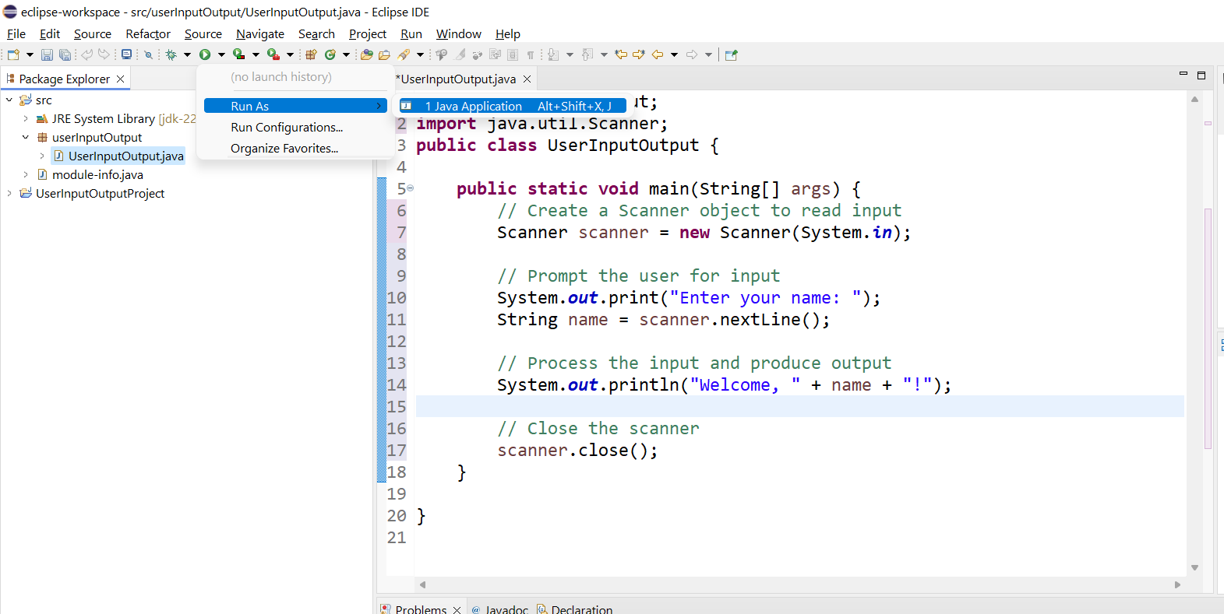
5. Run your Java program:
Right-click on your Java file (e.g., UserInputOutput.java).
Select Run As > Java Application.
This will execute your Java program, allowing you to enter your name and see the welcome message displayed in the console.

Slide 108
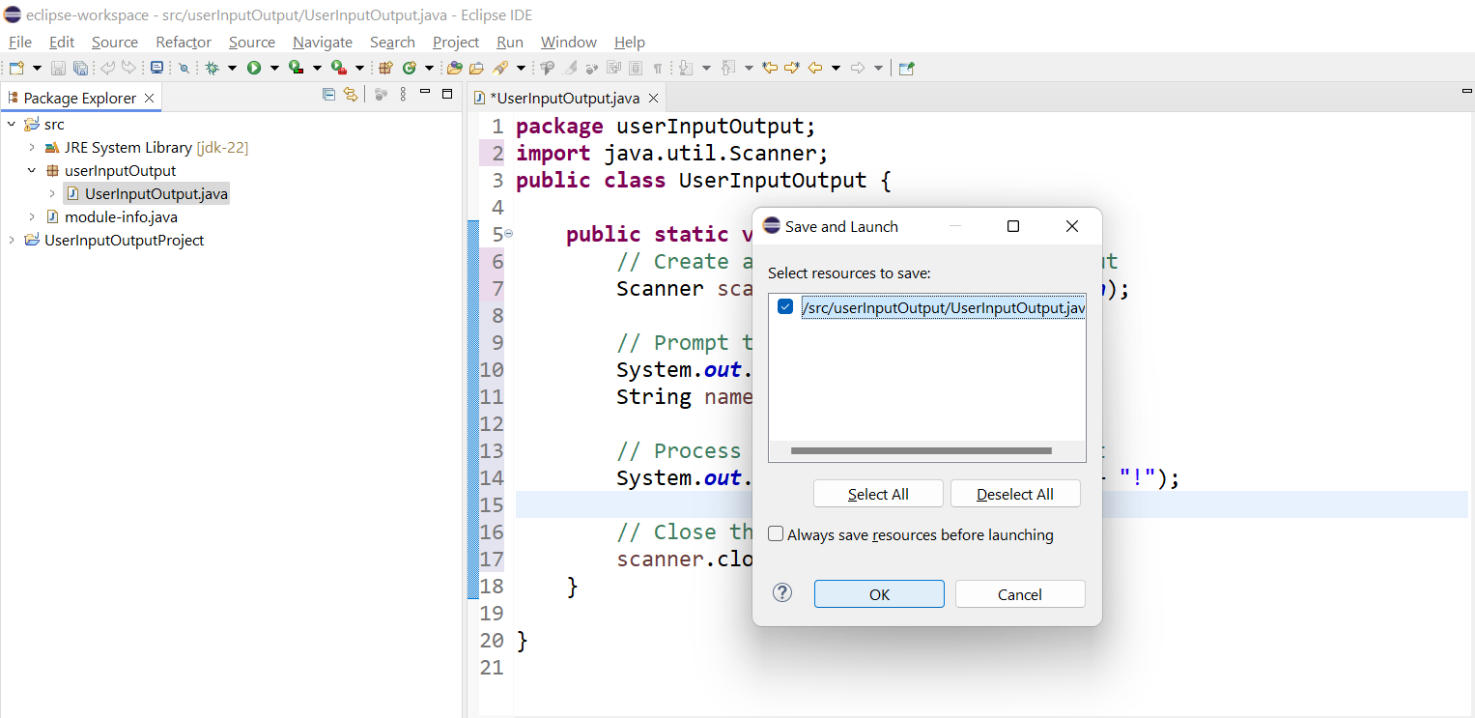
Select and Click on OK

Slide 109
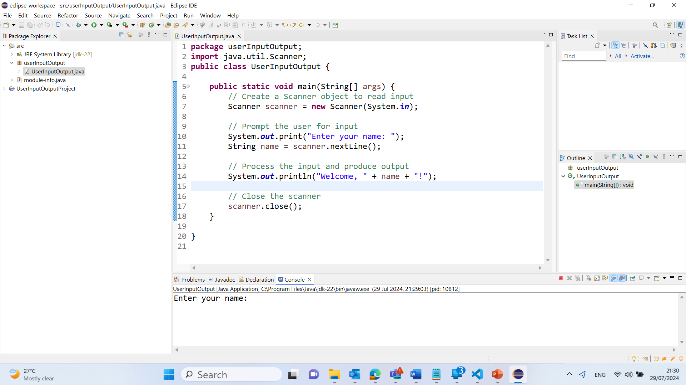
Output

Slide 110
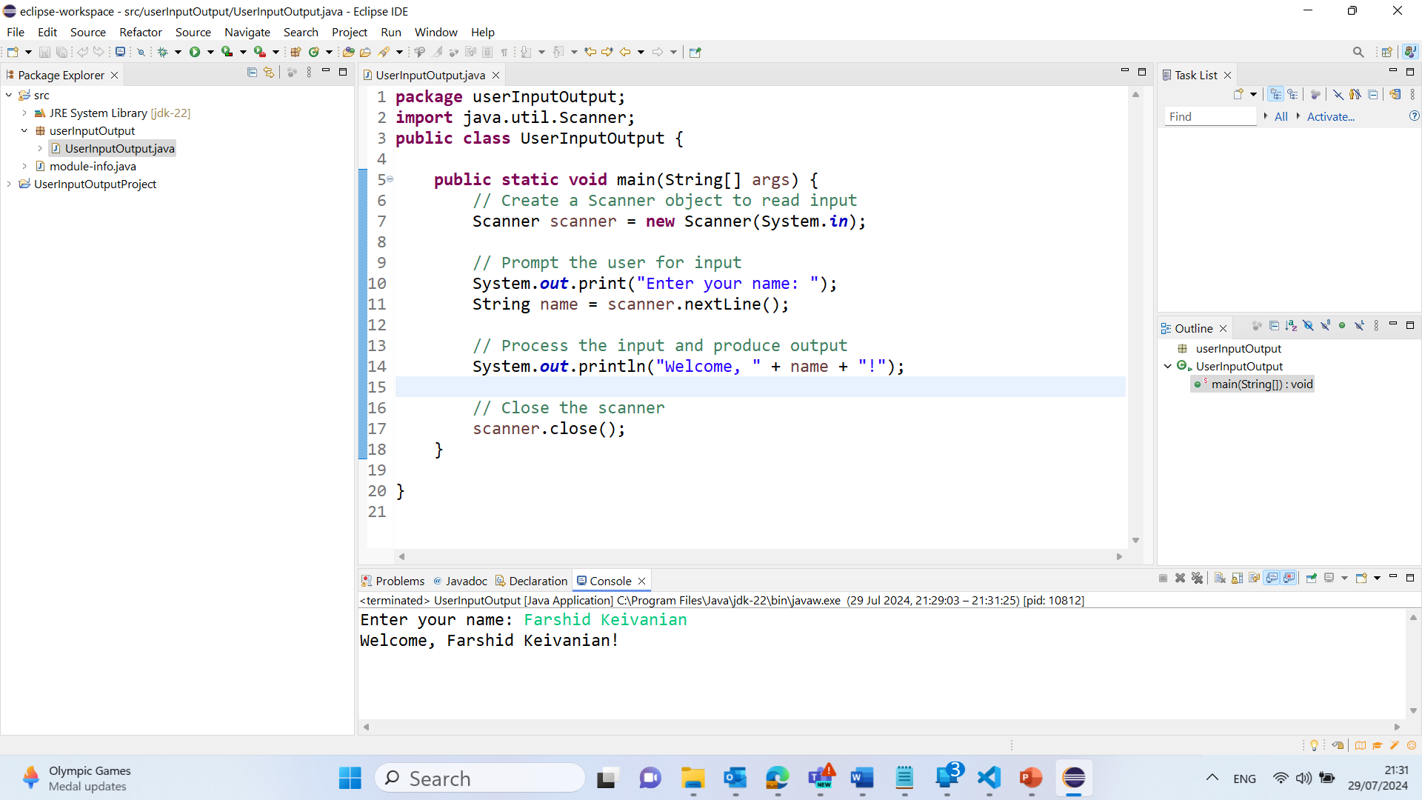
Output

Slide 111
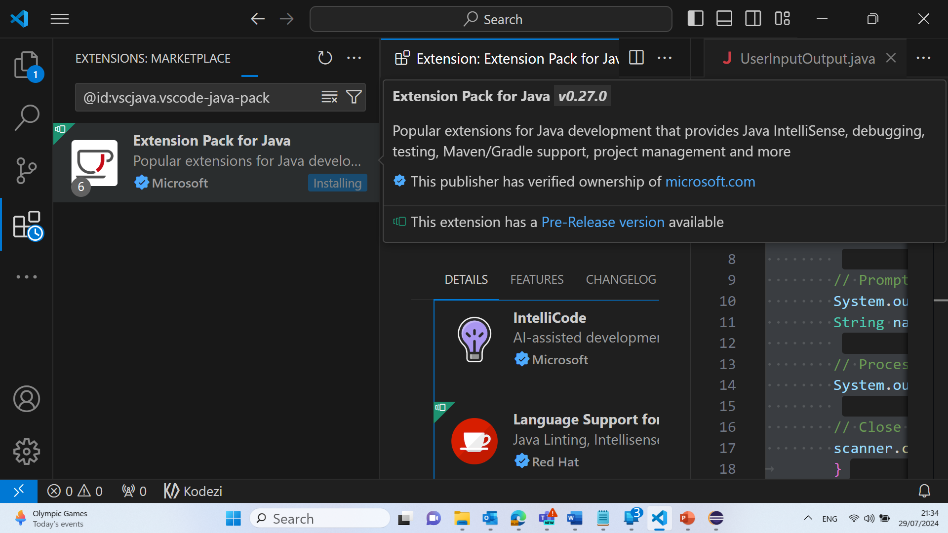
Visual Studio – Extension Pack for Java

Slide 112
Next week
After class TODO list:
Review the lecture
Read book chapter
Attempt assessment
Attend lab
Java Elementary Programming

